Slide 1
Programming Practice 01
In a Colab Cell, write code to do the following:
> for each of the integers 0-9, print out the > int plus 5
Challenge:
> define a function that would accept any
> highest integer, instead of only going to 9

Slide 2
Programming Practice Solution

Slide 3
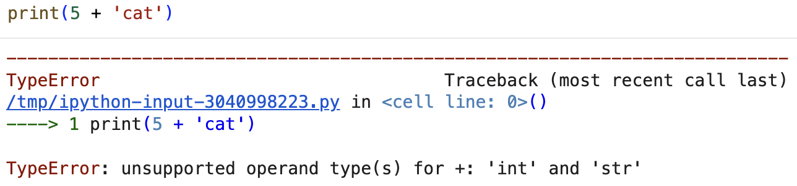
Type Errors
Last class we saw an error when we tried to add an int and a str together.

Slide 4
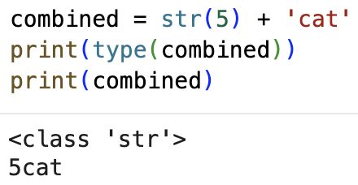
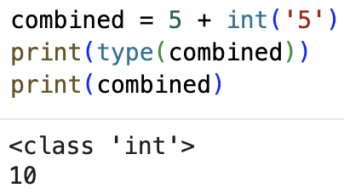
Typecasting
Typecasting allows us to change a variable or value to a different (supported) type!
NOTE: It is especially useful to typecast str into an int because usually when we read in data from a file, it all comes in as str

Slide 5
Programming Practice 02
define a function that can, given a list of ints, return a dictionary of counts of consecutive pairs.
For example:
pairs = count_consecutive_pairs([1, 2, 3, 1, 2])
print(pairs)
> {(1, 2): 2, (2, 3): 1, (3, 1): 1}

Slide 6
CSE 10124
Tokenization

Slide 7

Last Class - Text as Data
jabberwocky.txt
"Jabberwocky"
by Lewis Carroll
'Twas brillig, and the slithy toves
Did gyre and gimble in the wabe;
All mimsy were the borogoves,
And the mome raths outgrabe.
"Beware the Jabberwock, my son!
The jaws that bite, the claws that catch!
Beware the Jubjub bird, and shun
The frumious Bandersnatch!"
He took his vorpal sword in hand:
Long time the manxome foe he sought—
So rested he by the Tumtum tree,
And stood awhile in thought.

Slide 8
What is a Token

Slide 9
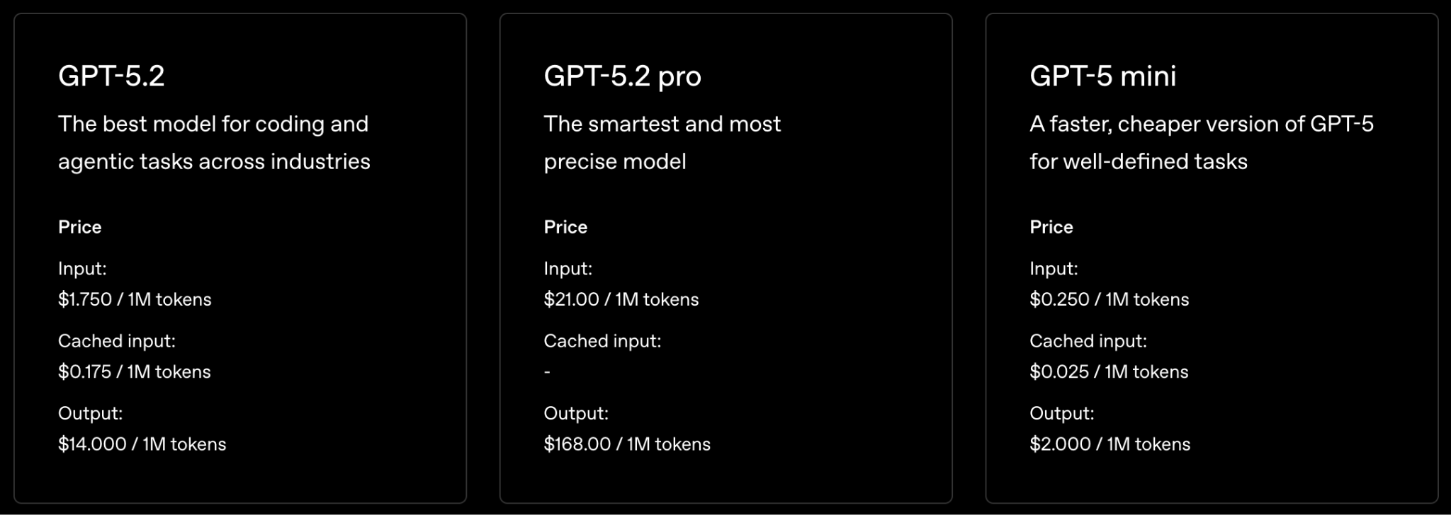
Tokens Today — OpenAI API
NOTE: An API is a set of URLs that allow code to access things automatically (like AI models)

Slide 10
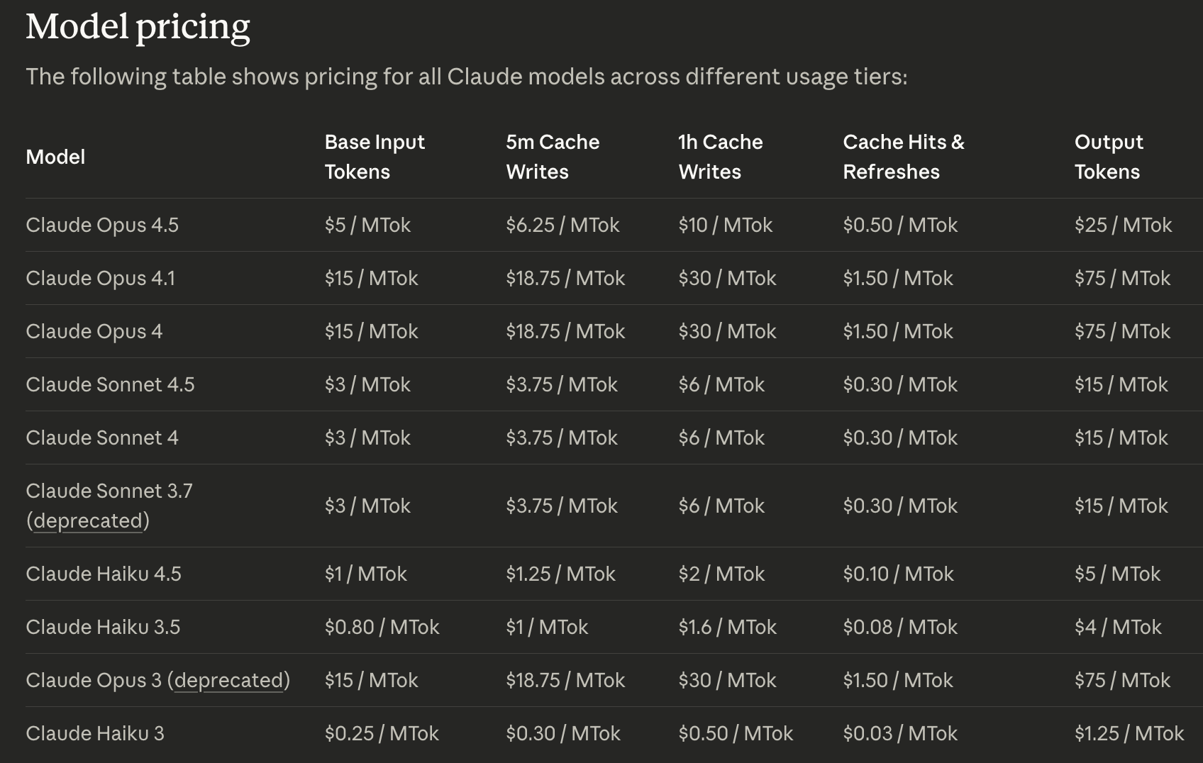
Tokens Today — Anthropic API

Slide 11
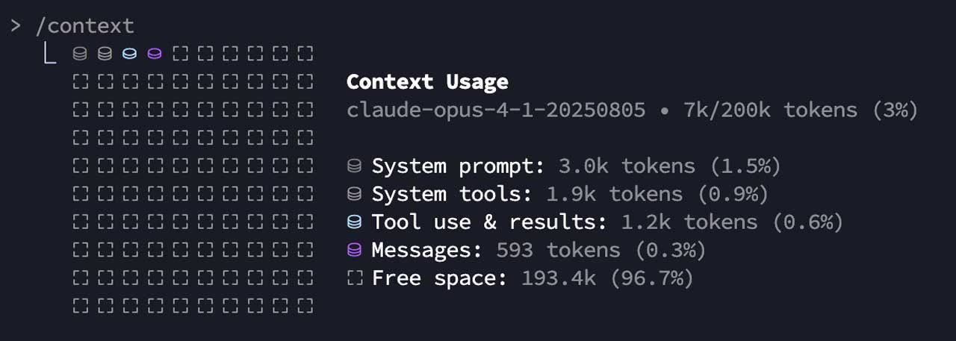
Tokens Today — Claude Code

Slide 12
Tokenization

Slide 13
Why do we Tokenize?

Slide 14
Byte-Pair Encoding Tokenization (1994)

Slide 15
Programming: Classes

